Slide 1
HTML5 Animations
-By Basker George

Slide 2
Agenda
CSS3 2D Transforms
CSS3 3D Transforms
CSS3 Transitions
CSS3 Animations
CSS3 Multiple columns
CSS3 selectors

Slide 3
6. CSS3 Transforms & Transitions
Transforms
CSS3 transform property lets you translate, rotate, scale, or skew any element on the page.
While some of these effects were possible using previously existing CSS features
(like relative and absolute positioning), CSS3 gives you unprecedented control over many more aspects
of an element’s appearance.
Transform-origin: By default, the origin of a transform is "50% 50%", which is exactly in the center of any given element. Changing the origin to "top left" causes the element to use the top left corner of the element as a rotation point. Values can be lengths, percentages or the keywords top, left, right, bottom, and center. The first value is the horizontal position, the second value is the vertical, and the third value represents the position on the Z axis. The third value will only work if you are using 3D transforms, and it cannot be a percentage.
Translation
Translation functions allow you to move elements left, right, up, or down.
These functions are similar to the behaviour of position: relative; where you declare top and left.
When you employ a translation function, you’re moving elements without impacting the flow of the
document.
Unlike position: relative, which allows you to position an element either against its current position or
against a parent or other ancestor, a translated element can only be moved relative to its current
position.
The translate(x,y) function moves an element by x from the left, and y from the top:
Notes:
3
Wondering what it takes to get started with html5?

Slide 4


6. CSS3 Transforms & Transitions
Examples
let’s say we want to move the word “dukes” over to the right when the
user hovers over it,
#ourExample h1:hover span {
color: #484848;
-webkit-transform: translateX(40px);
-moz-transform: translateX(40px);
-ms-transform: translateX(40px);
-o-transform:translateX(40px);
transform: translateX(40px);
}
Notes:
4
Wondering what it takes to get started with html5?

Slide 5

6. CSS3 Transforms & Transitions
Scaling
The scale(x,y) function scales an element by the defined factors horizontally and vertically, espectively. If only one value is provided, it will be used for both the x and y scaling.
Lets scale the same example
#ourExample h1:hover span {
color: #484848;
-webkit-transform: translateX(40px) scale(1.5);
-moz-transform: translateX(40px) scale(1.5);
-ms-transform: translateX(40px) scale(1.5);
-o-transform:translateX(40px) scale(1.5);
transform: translateX(40px) scale(1.5);
}
Notes:
5
Wondering what it takes to get started with html5?

Slide 6

6. CSS3 Transforms & Transitions
Rotation
The rotate() function rotates an element around the point of origin (as with scale,by default this is the element’s center), by a specified angle value. Generally, angles are declared in degrees, with positive degrees moving clockwise and negativemoving counter-clockwise.
Lets scale the same example
#ourExample h1:hover span {
color: #484848;
-webkit-transform:rotate(10deg) translateX(40px) scale(1.5);
-moz-transform:rotate(10deg) translateX(40px) scale(1.5);
-ms-transform:rotate(10deg) translateX(40px) scale(1.5);
-o-transform:rotate(10deg) translateX(40px) scale(1.5);
transform:rotate(10deg) translateX(40px) scale(1.5);
}
Notes:
6
Wondering what it takes to get started with html5?

Slide 7
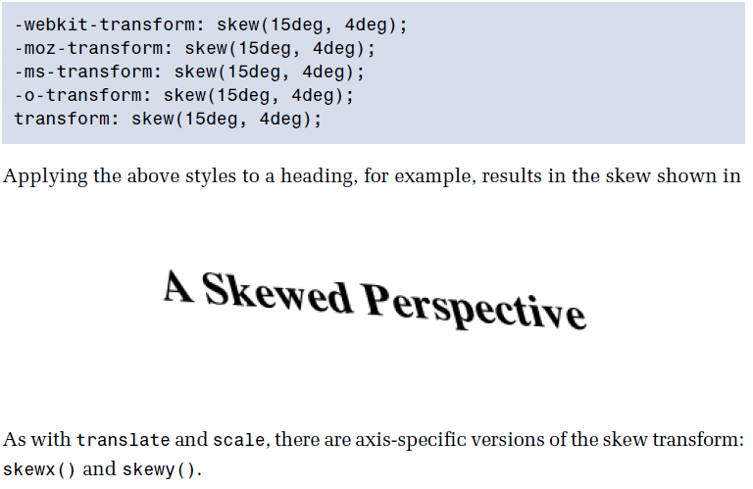
6. CSS3 Transforms & Transitions
Skew
The skew(x,y) function specifies a skew along the X and Y axes. As you’d expect, the x specifies the skew on the X axis, and the y specifies the skew on the Y axis.
If the second parameter is omitted, the skew will only occur on the X axis:
Notes:
7
Wondering what it takes to get started with html5?

Slide 8
CSS transitions: An introduction
Let’s start with CSS transitions. Transitions are the grease in the wheel of CSS transforms.
Without a transition, an element being transformed would change abruptly from one state to another.
By applying a transition you can control the change, making it smooth and gradual.
There are two properties that are required in order for the transition to take effect and two optional property
1. transition-property (required)
2. transition-duration (required)
3. transition-timing (optional)
4. transition-delay (optional)

Slide 9
Note: Each transition property can be defined individually, but for cleaner and faster code, it’s recommended that you use the transition shorthand.
div {
transition: [property] [duration] [timing-function] [delay];
}
The transition-property specifies the CSS property where the transition will be applied. You may apply a transition to an individual property (e.g., background-color or transform) or to all properties in the rule-set (i.e., all).
The transition-duration property specifies the time span of the transition. You can specify in seconds or milliseconds.
The transition-timing-function property allows you to define the speed of the transition over the duration. The default timing is ease, which starts out slow, quickly speeds up, and then slows down at the end. The other timing options are: linear, ease,ease-in, ease-out, and ease-in-out.
The transition-delay property allows you to specify when the transform will start. By default, the transition starts as soon as it is triggered (e.g., on mouse hover). However, if you want to transition to start after it is triggered you can use the transition delay property.

Slide 10
transition-timing-function
Linear: same speed
Ease: increase speed at beginning and slowdown at end
Ease-in: increase speed gradually
Ease-out: decrease speed gradually
Ease-in-out: combination of ease-in + ease-out

Slide 11
<!doctype html>
<html>
<head>
<meta charset="utf-8">
<title>Untitled Document</title>
<style>
h1:hover {
border: solid red;
width:300px;
background-color:blue;
transform-origin: 0 0;
transform: translateX(50px)rotate(45deg) scale(2.0) skew(15deg, 4deg);
transition: all 4s ease-in;
}
</style>
</head>
<body>
<p> <h1>This is an paragraph </h1></p>
</body>
</html>

Slide 12
CSS3 Transition Property
Provides for changes in property values to display in a smoother manner over a specified time. Example:
nav a:hover { color: #869dc7; background-color: #eaeaea;
transition: background-color 2s linear; }
Online Example: https://robots.thoughtbot.com/transitions-and-transforms

Slide 13
6. CSS3 Transforms & Transitions
Transitions
Transitions allow the values of CSS properties to change over time, essentially providing simple
animations. For example, if a link changes color on hover, you can have it gradually fade from one color
to the other, instead of a sudden change
Here are the steps to create a simple transition using only CSS:
1. Declare the original state of the element in the default style declaration.
2. Declare the final state of your transitioned element; for example, in a hover state.
3. Include the transition functions in your default style declaration, using a few different properties:
transition-property, transition-duration,transition-timing-function, and transition-delay.
list of properties that can be transitioned
■ background-color and background-position ■ border-color, border-spacing, and border-width
■ bottom, top, left, and right ■ clip ■ color ■ crop ■ font-size and font-weight ■ height and width
■ letter-spacing ■ line-height ■ margin ■ max-height, max-width, min-height, and min-width
■ opacity ■ outline-color, outline-offset, and outline-width ■ padding ■ text-indent ■ text-shadow
■ vertical-align ■ visibility ■ word-spacing ■ z-index
Notes:
13
Wondering what it takes to get started with html5?

Slide 14
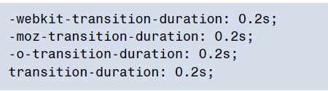
6. CSS3 Transforms & Transitions
Transition-duration
The transition-duration property sets how long the transition will take. You can specify this either in seconds (s) or milliseconds (ms).
We’d like our animation to be fairly quick, so we’ll specify 0.2 seconds,
or 200 milliseconds:
Notes:
14
Wondering what it takes to get started with html5?

Slide 15
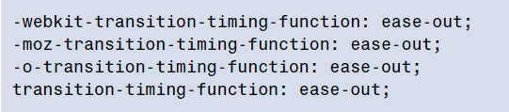
6. CSS3 Transforms & Transitions
Transition-timing-function
The transition-timing-function lets you control the pace of the transition in even more granular detail.
Do you want your animation to start off slow and get faster, start off fast and end slower
You can specify one of the key terms ease, linear, ease-in, ease-out, or ease in-out.
The best way to familiarize yourself with them is to play around and try them all.
Notes:
15
Wondering what it takes to get started with html5?

Slide 16
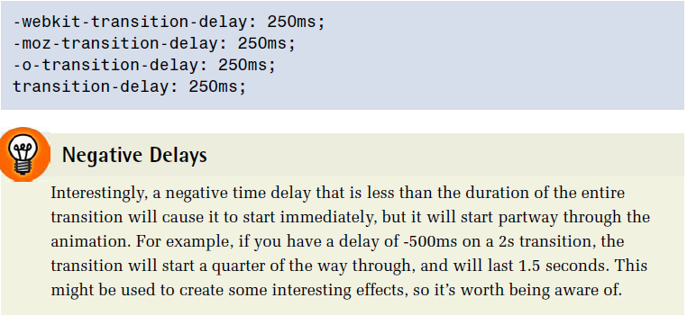
6. CSS3 Transforms & Transitions
Transition-delay
Finally, by using the transition-delay property, it’s also possible to introduce a delay before the animation begins.
Normally, a transition begins immediately, so the default is 0. Include the number of milliseconds (ms) or seconds(s) to delay the transition:
Notes:
16
Wondering what it takes to get started with html5?

Slide 17
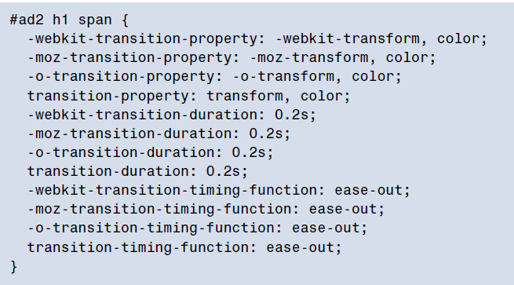
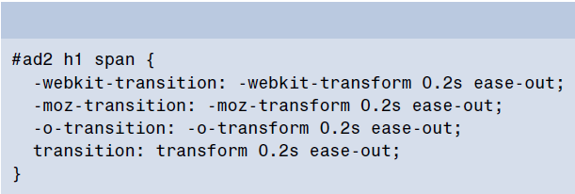
6. CSS3 Transforms & Transitions
Transition-shorthand property
With four transition properties and three vendor prefixes, you could wind up with 16 lines of CSS for a single transition.
Fortunately, as with other properties, there’s a shorthand available. The transition property is shorthand for the four transition
functions described above. Let’s take another look at our transition so far:
shorthand
Note that order of the values is important and must be as follows (though you don’t need to specify all four values):
1. transition-property
2. transition-duration
3. transition-function
4. transition-delay
Notes:
17
Wondering what it takes to get started with html5?

Slide 18
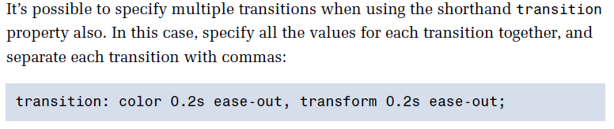
6. CSS3 Transforms & Transitions
Multiple transition
With four transition properties and three vendor prefixes, you could wind up with 16 lines of CSS for a single transition.
Fortunately, as with other properties, there’s a shorthand available.
The transition property is shorthand for the four transition functions described above.
Let’s take another look at our transition so far:
Notes:
18
Wondering what it takes to get started with html5?

Slide 19
6. CSS3 Animation
Transitions animate elements over time; however, they’re limited in what they can do.
You can define starting and ending states, but there’s no fine-grained control over any intermediate states.
CSS animations, unlike transitions, allow you to control each step of an animation via keyframes.
If you’ve ever worked with Flash, you’re likely very familiar with the concept of keyframes;
if not, don’t worry, it’s fairly straightforward.
A keyframe is a snapshot that defines a starting or end point of any smooth transition.
With CSS transitions, we’re essentially limited to defining the first and last keyframes. CSS animations
allow us to add any number of keyframes in between, to guide our animation in more complex ways.
Animation properties:
animation-name
animation-duration
animation-timing-function
animation-iteration-count
animation-direction
animation-delay
animation-fill-mode
Notes:
19
Wondering what it takes to get started with html5?

Slide 20
Animation
The animation property in CSS can be used to animate many other CSS properties such as color, background-color, height, or width.
Each animation needs to be defined with the @keyframes at-rule which is then called with the animation property:
For Example
<div class="element"></div>
.element { animation: change_color 5s infinite; }
@keyframes change_color {
0% { background-color: #001F3F; }
100% { background-color: #FF4136; }
}

Slide 21
Animation
Each @keyframes at-rule defines what should happen at specific moments during the animation.
For example, 0% is the beginning of the animation and 100% is the end.
These keyframes can then be controlled either by the shorthand animation property, or its eight sub-properties, to give more control over how those keyframes should be manipulated.

Slide 22
Sub-properties
animation-name: declares the name of the @keyframes at-rule to manipulate.
animation-duration: the length of time it takes for an animation to complete one cycle.
animation-timing-function: establishes preset acceleration curves such as ease or linear.
animation-delay: the time between the element being loaded and the start of the animation sequence.
animation-direction: sets the direction of the animation after the cycle. Its default resets on each cycle.
animation-iteration-count: the number of times the animation should be performed.
animation-fill-mode: sets which values are applied before/after the animation. For example, you can set the last state of the animation to remain on screen, or you can set it to switch back to before when the animation began.
animation-play-state: pause/play the animation.

Slide 23
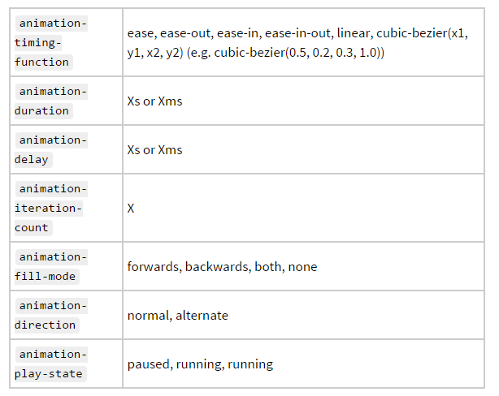

Slide 24
Multiple animations
@keyframes change_color { 0%, 100% { background-color: red; } 50% { background-color: orange; } }
@keyframes nudge { 0%, 100% { transform: translate(0, 0); }
.element { height: 400px; width: 400px; background-color: red; animation: change_color 3s ease infinite alternate, nudge 5s linear infinite alternate; border-radius: 100%; }

Slide 25
Performance
Animating most properties is a performance concern, so we should proceed with caution before animating any property.
However, there are certain combinations that can be animated safely:
transform: translate()
transform: scale()
transform: rotate()
Opacity

Slide 26
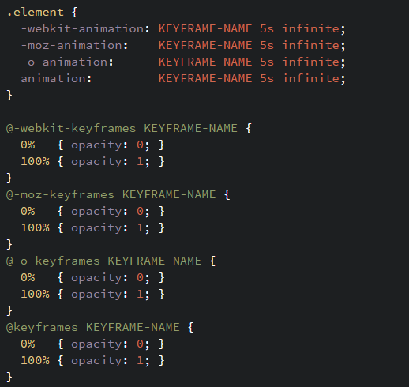
Although browser support is quite good for this property in modern browsers, we might want to support as many older browsers as we can. In that case we'd need to use vendor prefixes:

Slide 27
Online Animation Example:
https://robots.thoughtbot.com/css-animation-for-beginners

Slide 28
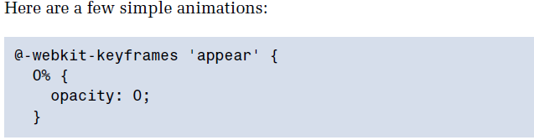
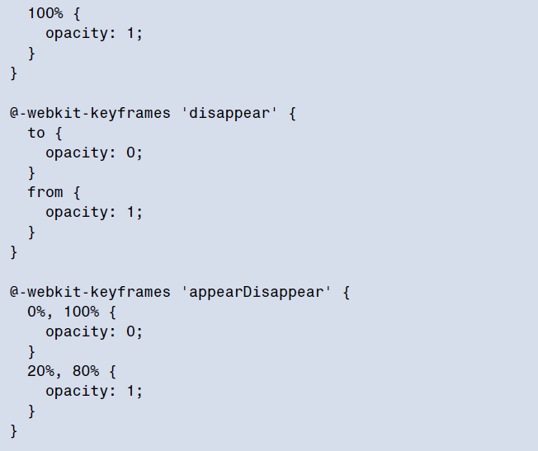
6. CSS3 Animation
To animate an element in CSS, you first create a named animation, then attach it to an element in that element’s property declaration block.
Animations in themselves don’t do anything; in order to animate an element, you will need to associate the animation with that element.
To create an animation, use the @keyframes
The last animation is worth paying extra attention to: we’ve applied the same styles to 0% and 100%, and to 20% and 80%.
In this case, it means the element will start out invisible (opacity: 0;), fade in to visible by 20% of the way through the duration, remain visible until 80%, then fade out.
We’ve created three animations, but they aren’t attached to any elements. Once we have defined an animation, the next step is to apply it to one or more elements using the various animation properties.
Notes:
28
Wondering what it takes to get started with html5?

Slide 29
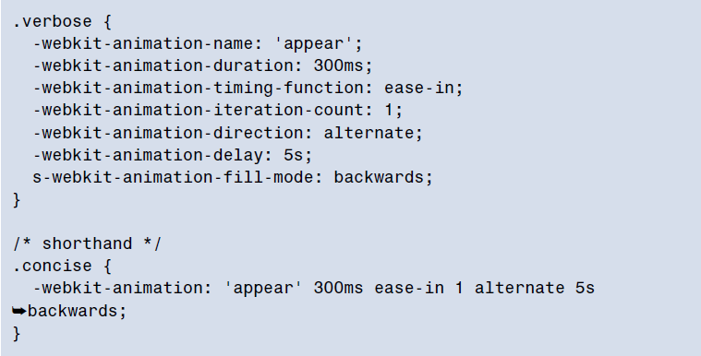
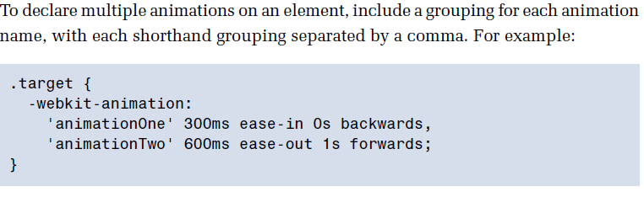
6. CSS3 Animation
Shorthand
The animation property takes as its value a space-separated list of values for the longhand animation name,
animation-duration, animation-timing-function, animation-delay, animation-iteration-count, animation-direction,
and animation-fill-mode properties:
Notes:
29
Wondering what it takes to get started with html5?

Slide 30
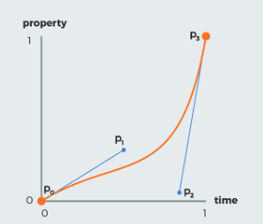
Example
A transition effect with variable speed from start to end:
div {
width: 100px;
height: 100px;
background: red;
transition: width 2s;
transition-timing-function: cubic-bezier(0.1, 0.7, 1.0, 0.1);
}
Definition and Usage
The cubic-bezier() function defines a Cubic Bezier curve.
A Cubic Bezier curve is defined by four points P0, P1, P2, and P3. P0 and P3 are the start and the end of the curve and, in CSS these points are fixed as the coordinates are ratios. P0 is (0, 0) and represents the initial time and the initial state, P3 is (1, 1) and represents the final time and the final state.
The cubic-bezier() function can be used with the animation-timing-function property and the transition-timing-function property.

Slide 31
<!DOCTYPE html>
<html>
<head>
<style>
div {
width: 100px;
height: 100px;
background: red;
transition: width 2s;
transition-timing-function: cubic-bezier(0.1, 0.7, 1.0, 0.1);
}
div:hover {
width:300px;
}
</style>
</head>
<body>
<h1>The cubic-bezier() Function</h1>
<p>Hover over the div element below, to see the transition effect.</p>
<div></div>
<p><b>Note:</b> This example does not work in Internet Explorer 9 and earlier versions.</p>
</body>
</html>

Slide 32
6. CSS3 multiple columns
Newspaper-style columns have been close to impossible to accomplish with CSS and HTML without forcing column breaks at
fixed positions
With CSS3 columns, the browser determines when to end one column and begin the next without requiring any extra markup.
You retain the flexibility to change the number of columns as well as their width, without having to go back in and alter the
page’s markup.
The column-count-property
The column-count property specifies the number of columns desired, and the maximum number of columns allowed.
The default value of auto means that the element has one column.
Ex: #primary article .content {
-webkit-column-count: 3;
-moz-column-count: 3;
column-count: 3;
}
Notes:
32
Wondering what it takes to get started with html5?

Slide 33
6. CSS3 multiple columns
The column-gap-property
The column-gap property specifies the width of the space between columns:
Ex: #primary article .content {
-webkit-column-gap: 10px;
-moz-column-gap: 10px;
column-gap: 10px;
}
The column-width-property
The column-width property is like having a min-width for your columns.
The browser will include as many columns of at least the given width as it can to fill up the element
For example, if we have a parent that is 400 pixels wide, a 10-pixel column gap, and the column-width is declared as 150px,
the browser can fit two columns:(400px width – 10px column gap) ÷ 150px width 2.6
The browser rounds down to two columns, making columns that are as large as possible in the allotted space;
in this case that’s 195px for each column—the total width minus the gap, divided by the number of columns.
Even if the column-count were set to 3, there would still only be two columns, as there’s not enough space to include three columns of the specified width.
In other words, you can think of the column-count property as specifying the maximum column count.
Ex: #primary article .content {
-webkit-column-width: 150px;
-moz-column-width: 150px;
column-width: 150px;
}
Notes:
33
Rounds of even there is no enough space

Slide 34
6. CSS3 multiple columns
The column-rule-property
Column rules are essentially borders between each column. The column-rule property specifies the
color, style, and width of the column rules. The rule will appear in the middle of the column gap Ex: #primary article .content {
-webkit-column-rule: 1px solid #ccc;
-moz-column-rule: 1px solid #ccc;
column-gap: 1px solid #ccc;
}
Notes:
34
Rounds of even there is no enough space

Slide 35
6. CSS3 selectors
Selectors are at the heart of CSS. Without selectors to target elements on the page,
the only way to modify the CSS properties of an element would be to use the element’s
style attribute and declare the styles inline. This, of course, is ugly, awkward,
and unmaintainable. So we use selectors.
Relational selectors
Descendant (E F)
You should definitely be familiar with this one. The descendant selector targets any element F that is a
descendant (child, grandchild, great grandchild, and so on) of an element E.
Child (E > F)
This selector matches any element F that is a direct child of element E—any further nested elements will
be ignored. Continuing the above example, ol > li would only target li elements directly inside the ol, and
would omit those nested inside a ul.
Adjacent Sibling (E + F)
This will match any element F that shares the same parent as E, and comes directly after E in the
markup. For example, li + li will target all li elements except the first li in a given container.
General Sibling (E ~ F)
This one’s a little trickier. It will match any element F that shares the same parent as any E and comes
after it in the markup. So, h1~h2 will match any h2 that follows an h1, as long as they both share the
same direct parent—that is, as long as the h2 is not nested in any other element.
Notes:
35
Rounds of even there is no enough space

Slide 36
6. CSS3 selectors
Attribute selectors
E[attr$=val] (IE8+, WebKit, Opera, Mozilla)
Matches any element E whose attribute attr ends in val. In other words, the val matches the end of the
attribute value.
E[attr*=val] (IE8+, WebKit, Opera, Mozilla)
Matches any element E whose attribute attr matches val anywhere within the attribute. In other words,
the string val is matched anywhere in the attribute value. It is similar to E[attr~=val] above, except the
val can be part of a word.
Using the same example as above, .fakelink[title~=info] {} would match any element with the class
fakelink that has a title attribute containing the string info, such as "Click here for more information."
Notes:
36
Rounds of even there is no enough space

Slide 37
6. CSS3 selectors
Pseudo-classes
:enabled
A user interface element that’s enabled.
:disabled
Conversely, a user interface element that’s disabled.
:checked
Radio buttons or checkboxes that are selected or ticked.
:valid
Applies to elements that are valid, based on the type or pattern attributes
:invalid
Applies to empty required elements, and elements failing to match the requirements defined by the type or pattern attributes.
:in-range
Applies to elements with range limitations, where the value is within those limitations. This applies, for example, to number and range input types with min and max attributes
:out-of-range
The opposite of :in-range: elements whose value is outside the limitations of their range.
:required
Applies to form controls that have the required attribute set.
:optional
Applies to all form controls that do not have the required attribute.
:read-only
Applies to elements whose contents are unable to be altered by the user. This is usually most elements other than form fields.
:read-write
Applies to elements whose contents are user-alterable, such as text input fields
Notes:
37
Rounds of even there is no enough space

Slide 38
6. CSS3 selectors
Structural Pseudo-classes
:root
The root element, which is always the html element.
E F:nth-child(n)
The element F that is the nth child of its parent E.
E F:nth-last-child(n)
The element F that is the nth child of its parent E, counting backwards from the last one. li:nth-last-child(1) would match the
last item in any list—this is the same as li:last-child (see below).
E:nth-of-type(n)
The element that is the nth element of its type in a given parent element.
E:nth-last-of-type(n)
Like nth-of-type(n), except counting backwards from the last element in a parent.
E:first-child
The element E that is the first child E of its parent. This is the same as :nthchild(1).
E:last-child
The element E that is the last child E of its parent, same as :nth-last-child(1).
E:first-of-type
Same as :nth-of-type(1).
E:last-of-type
Same as :nth-last-of-type(1).
E:only-child
An element that’s the only child of its parent.
E:only-of-type
An element that’s the only one of its type inside its parent element.
E:empty
An element that has no children; this includes text nodes, so <p>hello</p> will not be matched.
E:lang(en)
An element in the language denoted by the two-letter abbreviation (en).
E:not(exception)
This is a particularly useful one: it will select elements that don’t match the selector in the parentheses.
Notes:
38
Rounds of even there is no enough space

Slide 39
HTML5 APIs
API – a protocol that allows software components to communicate – interacting and sharing data
A variety of APIs that are intended to work with HTML5, CSS, and JavaScript are currently under development and in the W3C approval process, including:
geolocation
web storage
offline web applications
canvas

Slide 40
HTML5 Geolocation
Allows your web page visitors to share their geographic location
Their location may be determined by the IP address, wireless network connection, local cell tower, or GPS hardware depending on the type of device and browser.
JavaScript is used to work with the latitude and longitude coordinates provided by the browser.
Examples:
http://webdevfoundations.net/geo and http://html5demos.com/geo

Slide 41
HTML5 Web Storage
Traditionally, the JavaScript cookie object has been used to store information in key-value pairs on the client (the website visitor’s computer).
NEW FOR HTML5: Web Storage API
provides two new ways to store information on the client side: local storage and session storage.
Advantage: increase in the amount of data that can be stored (5MB per domain).
The localStorage object stores data without an expiration date.
The sessionStorage object stores data only for the duration of the current browser
JavaScript is used to work with the values stored in the localStorage and sessionStorage objects.
Examples:
http://webdevfoundations.net/storage and http://html5demos.com/storage

Slide 42
HTML5 Offline Web Applications
An offline web application enables website visitors to view documents and access web applications even when they are not connected to the Internet.
A web application (app) can be written with HTML, CSS and JavaScript and can run in any browser – as long as you are online.
An offline web application takes this one step further and stores the HTML, CSS, and JavaScript files on the visitor’s device for use offline, even when the device is not connected to the Internet.
Examples:
http://html5demos.com/offlineapp
http://www.w3schools.com/html/html5_app_cache.asp

Slide 43
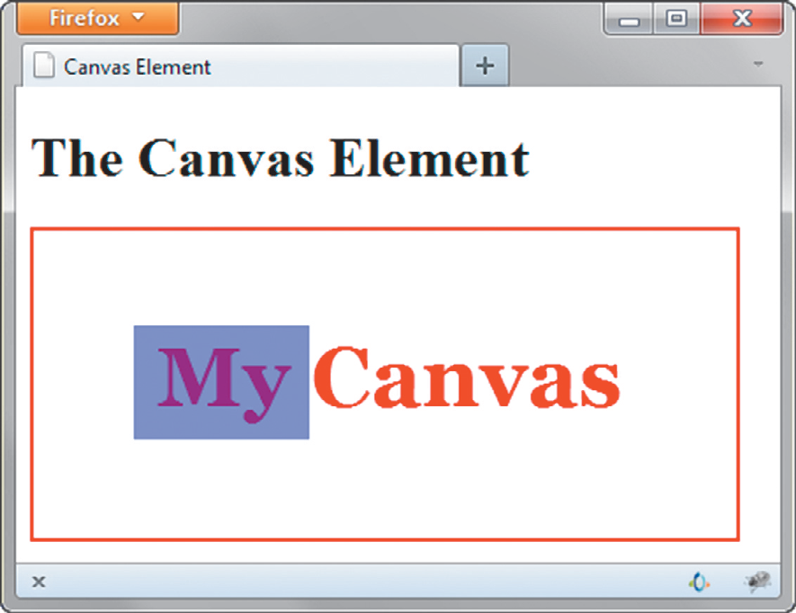
HTML5 Canvas Element
Configures dynamic graphics
Draw lines, shapes, text, image
Interact with actions taken by the user
Canvas API (application programming interface)
JavaScript – client-side scripting language
<script type="text/javascript">
function drawMe() {
var canvas = document.getElementById("myCanvas");
if (canvas.getContext) {
var ctx = canvas.getContext("2d");
ctx.fillStyle = "rgb(255, 0, 0)";
ctx.font = "bold 3em Georgia";
ctx.fillText("My Canvas", 70, 100); ctx.fillStyle = "rgba(0, 0, 200, 0.50)";
ctx.fillRect (57, 54, 100, 65);
}
}
</script>

Slide 44
Summary
This chapter introduced the HTML techniques and technologies used to configure sound, video, and interactivity on web pages.
Issues related to accessibility and copyright were also discussed.
The number one reason for visitors to leave web pages is too long of a download time. When using multimedia, be careful to minimize this issue.

